Slide 1
Research Town Hall
May 13, 2020
Dennis Charney
Eric Nestler
Marta Filizola
Reg Miller
Gopi Patel
Rosalind Wright

Slide 2
COVID-19 Cases in the Mount Sinai Health System
Number of COVID-19 inpatients in the MSHS
Research
ramp down
Monday
Number of new COVID-19 patients admitted to a MSHS hospital
Research
ramp down
Monday

Slide 3
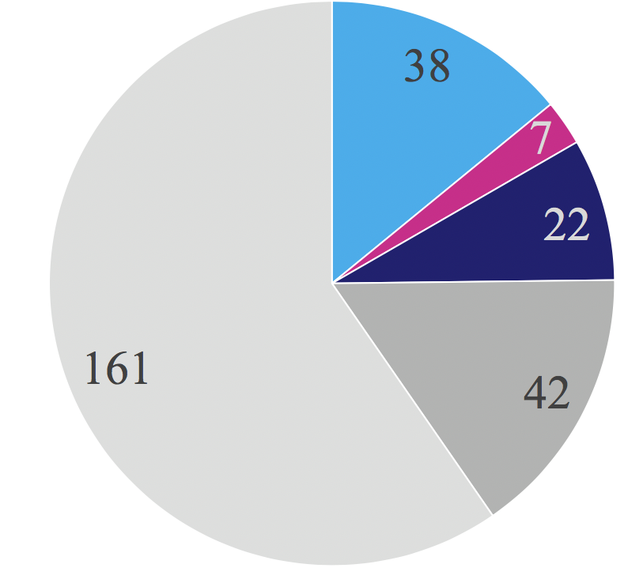
Mount Sinai Research in the Time of COVID-19
NIH
COVID-19
submissions
Other federal
Total research submissions are up by ~6% compared with last year:
Industry
ISMMS
Other
~$5.5M in COVID19 supplements from NIH to date, with more coming….

Slide 4
Plan to Ease Restrictions on Research Laboratories
Phase 1 – Beginning Monday, May 18:
Wet laboratory research—non-COVID19 related—will resume at 25% normal occupancy. (All medical research is considered essential work by NYS and NYC.)
COVID19 related research will continue at its present 100% effort.
By staggering hours and days, it should be possible for most people in most laboratories to get a substantial amount of work under way.
Computational researchers, and administrative/financial staff, should continue to work from home but are free to return to campus when necessary (but maintaining 25% normal occupancy).
Return to work during Phase 1 is completely voluntary.
• People should report coercion via Feedback Form, HR, chairs, or leadership.

Slide 5
Plan to Ease Restrictions on Research Laboratories
Phase 1 – Beginning on Monday, May 18 (con’t):
There should be 1 person working at any given time per laboratory bay.
• Some procedures require closer work: minimize, wear masks, practice hygiene.
Similar reductions in density in all procedure rooms and in lunch/break rooms.
• All floor conference rooms will be available for lunches and breaks.
Social distancing (≥6’) should be maintained at all times possible.
Face masks must be worn at all times on campus.
• Each laboratory’s LSO will be able to obtain enough masks each week to
distribute 1 mask/day/person. We ask that people wear their own masks to work.
Frequent lab cleaning (start/end each day or each shift).
• Normal housekeeping activities will resume for labs and common areas.

Slide 6
Plan to Ease Restrictions on Research Laboratories
Phase 1 – Beginning on Monday, May 18 (con’t):
Continue improved handwashing and other hygiene activities.
Avoid crowding of elevators and elevator lobbies (maintain social distancing).
Testing:
• Any person who is symptomatic should not come to work.
• Any person who becomes symptomatic should go home immediately.
• All symptomatic people should notify their PI and EHS (Employee Health Services) or Student Health and Wellness and schedule a test for the virus.
• All symptomatic people should self-isolate for 10* days (*subject to change).
• Anyone exposed to symptomatic people should closely monitor themselves for symptoms.
• All employees and trainees will be able to get tested for anti-COVID19 antibodies (but it will take some time—prioritized by an individual’s circumstances).

Slide 7
Plan to Ease Restrictions on Research Laboratories
Phase 1 – Beginning on Monday, May 18 (con’t):
Until further notice, all meetings of groups of people will be done by Zoom.
• This includes WIPs, classrooms, research seminars, and thesis proposals, committee meetings, and defenses, etc.
We would like targeted faculty recruitment efforts to continue, but for now this should also be done by Zoom.
It is likely that all, or nearly all, summer interns will have to be cancelled.
• Exceptions could be made for those who can do computational work from home.

Slide 8
Responsibility for Conduct of Research Laboratories
We all have shared responsibility:
PIs and their home department/institute chairs/directors are ultimately responsible for adhering to these guidelines.
Designated safety officers (DSOs) will inspect every lab every day. EnvHS will be conducting their own spot checks. Both will report labs that are in violation.
PIs who violate these guidelines will have their laboratories completely shut down to enable an investigation.
Exceptions to the guidelines must be approved by writing to Eric Nestler.
Counting on good citizenship: The character of an individual viewed as a member of society; behavior in terms of duties, obligations, and functions. (Dictionary.com)

Slide 9
Further Easing of Restrictions on Research Laboratories
Phase 2 – What will this look like?
We will monitor closely rates of infection and consider further easing of restrictions at some future point.
• We want to ramp up in as timely a manner as we can safely do so.
• Your cooperation, and strict adherence to Phase 1 guidelines, will enable a faster transition to Phase 2.
We are heartened by our experience over the past two months that healthcare workers, and those engaged in COVID19 related research, have shown no evidence of increased risk for infection—in fact, they have displayed lower rates of infection—compared to the general public.
At some point, everyone who needs to be on campus to get their work done must return to campus. The timing of requiring such a return is under discussion.

Slide 10
YOUR QUESTIONS
http://researchroadmap.mssm.edu/reference/covid-19-guidance/
https://www.mountsinai.org/about/safety-hub/staff/staff-resources
https://www.mountsinai.org/about/covid19/staff-resources/well-being
https://www.mountsinai.org/about/covid19/staff-resources/employee-health
Reg Miller – Specifics of resuming partial operations
Roz Wright – Timetable for ramping up clinical research
Gopi Patel – Testing
Marta Filizola – Graduate School efforts

Slide 11
Ramping Up: Research
Reginald W. Miller, DVM, DACLAM
Icahn School of Medicine at Mount Sinai

Slide 12
Returning to the Lab – Safely
Two primary sites for information
General: https://www.mountsinai.org/about/COVID
Research Specific: http://researchroadmap.mssm.edu/rrm/
EvHS Laboratory Checklist
Biosafety Guidelines for COVID-19 Research
BSL2 Enhanced or BSL3
Enhanced = Biosafety Cabinet (Preferred) or Increased PPE.
Some COVID related research not using Infectious Agents…

Slide 13
Research PPE Distribution Plan
Overview:
Available: PPE (Surgical Mask)
One Mask/Person/Day = 5 Masks/Person/Week.
FREE at this time – Donated supplies.
researchPPErequest@mssm.edu
Three distribution sites:
Annenberg 21
Icahn 3
Hess 6

Slide 14
Other available PPE
Gloves
Face Shields
Gowns
We will NOT distribute N95 Respirators
Must go thru STAT Stores (GP LEVEL SC1)
Requires Fit Testing Confirmation.

Slide 15
Cores and shared research resources
Cores have remained open but will increase use
All have developed plans for:
Social Distancing – Spacing by scheduling
Equipment sanitation
Switching to Core sample processing when feasible (cost adjusted).
CCMS has developed plans for animal ordering and room use.
See CCMS website or contact office.

Slide 16
Acknowledgements
DSO Group = Departmental/Designated Safety Officers
Appointed by Chairs, Institute/Center Directors
Both and local and institutional role.
Work closely with Laboratory Safety Officers (LSO)
Focus: Developing a “Culture of Safety”
List available on http://researchroadmap.mssm.edu/rrm/(EvHS)

Slide 17
PPE Working Group
Chris Cannistraci - Hasso Platner Institute for Digital Health
Fanny Tang – Genetics and Genomic Sciences
Sandy Hatem – TCI and Precision Immunology Institute
Chen Wang – Microbiology
Bill Janssen – Neuroscience
Josef Ehntholt – Environmental Health & Safety
Kaware Richardson – Dean’s Office/CCMS
Anthony Smalls – Dean’s Office
SPECIAL THANKS!
Korgun Maral, Director of Materials Management, MSH
Carlos Maceda, Director, Supply Chain, MSHS

