Slide 1
Phased Resumption of Clinical Research Including Non-COVID Studies May 13, 2020 Rosalind J. Wright, MD MPH Dean, Translational Biomedical Research

Slide 2
MOUNT SINAI COVID-19 CLINICAL TRIALS DEVELOPMENT PLATFORM
Outpatient COVID-19
Inpatient COVID-19
Prophylactic
Prophylactic High Risk
Outpatient Mild Disease
Moderate disease
Severe disease
Critical disease
Multi-system dysfunction
Convalescent Plasma
Convalescent Plasma
Convalescent Plasma
Convalescent Plasma
Abs
Hyperimmune globulin
Hyperimmune globulin
Hyperimmune globulin
Hyperimmune globulin
Hyperimmune globulin
DNA vaccine Inovio
Vaccine
Hydroxychloroquine
Hydroxycholoroquine +/- AZM
Hydroxycholoroquine +/- AZM
Hydroxycholoroquine +/- AZM
Hydroxycholoroquine +/- AZM
Anti-viral
Remdesivir
Remdesivir
Remdesivir,
Enrolling, Enrolled
IFN lambda
Approved, Developing
Hiiltonol, pICLC
Proposed, Considering
Hiiltonol, pICLC (Pr CA)
Hiiltonol, pICLC (Pr CA)
Vaccine
Sarilumab anti-IL6R
Sarilumab anti-IL6R
Sarilumab anti-IL6R
Conv Antibodies
Remestemcel-L (MSC); Anti-ARDS, regeneration
Direct Acting Antivirals
Remestemcel-L (MSC); anti-ARDS, regeneration
Immune
Mod
Immune-Targeted
Gimsulumab, anti-GMCSFR (block ARDS)
Gimsulumab, anti-GMCSFR (block ARDS)
Gimsulumab, anti-GMCSFR (block ARDS)
Immune-Broad
Eculizumab, (anti-C5a)
Eculizumab, (anti-C5a)
Eculizumab, (anti-C5a)
Pulmonary Crit Care
Cancer Related
Cenicriviroc, (CCR2/CCR5 antagonist)
Cenicriviroc, (CCR2/CCR5 antagonist)

Slide 3
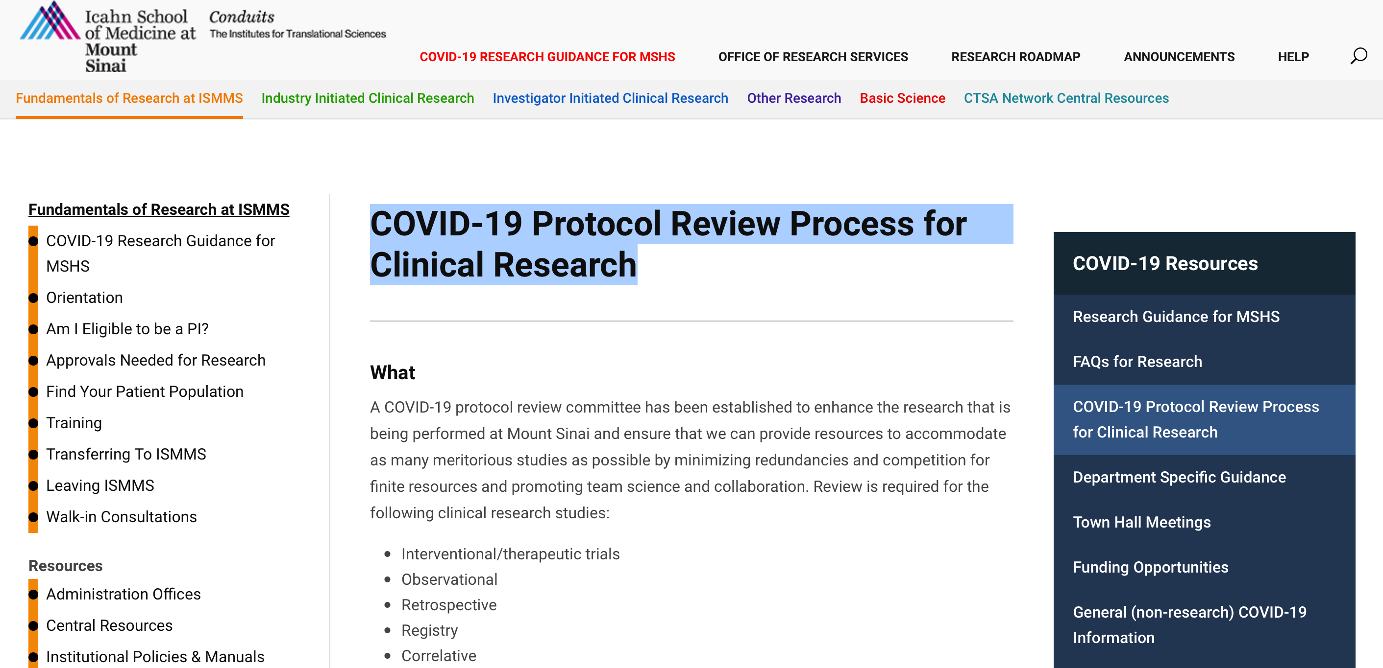
COVID-19 Protocol Clinical Research Guidance

Slide 4
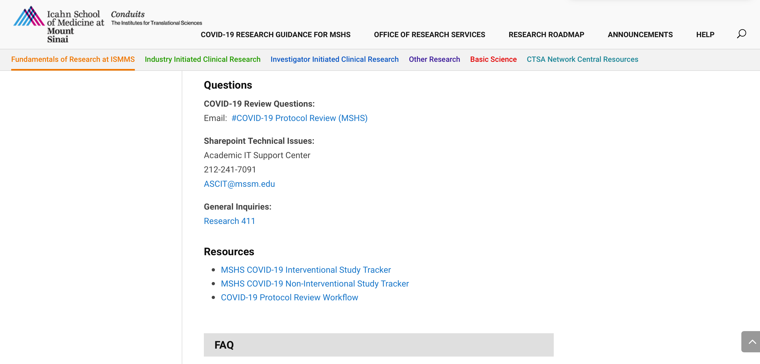
COVID-19 Protocol Questions Website

Slide 5
Observational/Non-interventional Studies
184 applications received*
169 sent for review
134 reviewed
115 approved
6 disapproved
13 revise & resubmit
* As of 5/12 @ 3PM

Slide 6
Phase 1 – Effective May 18th for at least two weeks:
The safety of our patients and research staff is the overarching consideration in planning to resume clinical research involving in-person encounters
Balancing maximal compliance with the protocol with need to minimize exposure of trial participants/staff to coronavirus
Research always involves shared decision on risk/benefit with added considerations:
Understanding of COVID risk as well as traditional risks
Given underlying comorbidities, how vulnerable patients are to coronavirus infection and/or severe course if infected
Risk of exposure given travel to and from clinical site
Feasibility issues needing consideration for in-person visits
How comfortable will patients be to travel to/from clinical site?
In-person visits will be resumed in phases, effective May 18, 2020 we will resume essential clinical trials (e.g., ongoing intervention studies requiring study drug where risk/benefit decision supports such)
When remote encounters aren’t possible, study patients must be seen in an ambulatory practice area for screening.
5 East 98th, Hess, CAM

Slide 7
Phase 1 – Effective May 18th for at least two weeks:
Ambulatory area guidance - Guidelines for Return to Practice.
Note process for pre-visit screening and day of visit registration on page 10
Proactively reach out to patients 24 hours prior to their scheduled appointment to screen for COVID symptoms.
Provide guidance to arrive 20 minutes prior to scheduled visit given need for pre-visit screening
The Health System’s Visitor Policy applies – only patients for whom a support person has been deemed essential will be allowed one healthy visitor
https://www.mountsinai.org/about/covid19/staff-resources/policies
Feasibility issues needing consideration for in-person visits
Does study require support from clinical services such as radiology, endoscopy, etc?
It is the responsibility of the study team to coordinate with the relevant ambulatory practice as needed to ensure these expectations are met

Slide 8
Phase 1 – Effective May 18th for at least two weeks:
Study teams should continue to schedule encounters remotely whenever possible, particularly while NYC remains under a stay-in-place executive order
Consider performing safety visits remotely and use of external lab/blood draw services for safety monitoring when possible

Slide 9
Phase 1 – Effective May 18th for at least two weeks:
Clinical Research Unit (CRU)
Current policies and procedures will be revised to align with the Guidelines for Return to Practice.
Patients must enter through the 5 East 98th Street entrance to be screened including a temperature check before coming to the CRU
Walk-in phlebotomy will not be offered. All phlebotomy visits must be scheduled.
Contact Joanne.Zephir@mssm.edu with any questions.

Slide 10
Phase 2 - Revisit in two weeks considering
NYS and NYC Executive Orders
Experience data from ambulatory practices
Changes in hospital metrics

